Slide 1

BINARY TREE
BY
MIRUNAALINI K J
Notes:
Data structure- organising and storing data in some order – easy access

Slide 2
What is Binary Tree?
Tree contains at most two children (i.e Not more the two)
A left child and A right child

Slide 3
Parent
Left child
Right
child

Slide 4
What is Binary Tree?
Tree contains at most two children (i.e Not more the two)
A left child and A right child
Top most node in the binary tree are called ROOT
Bottom most nodes are called LEAVES

Slide 5
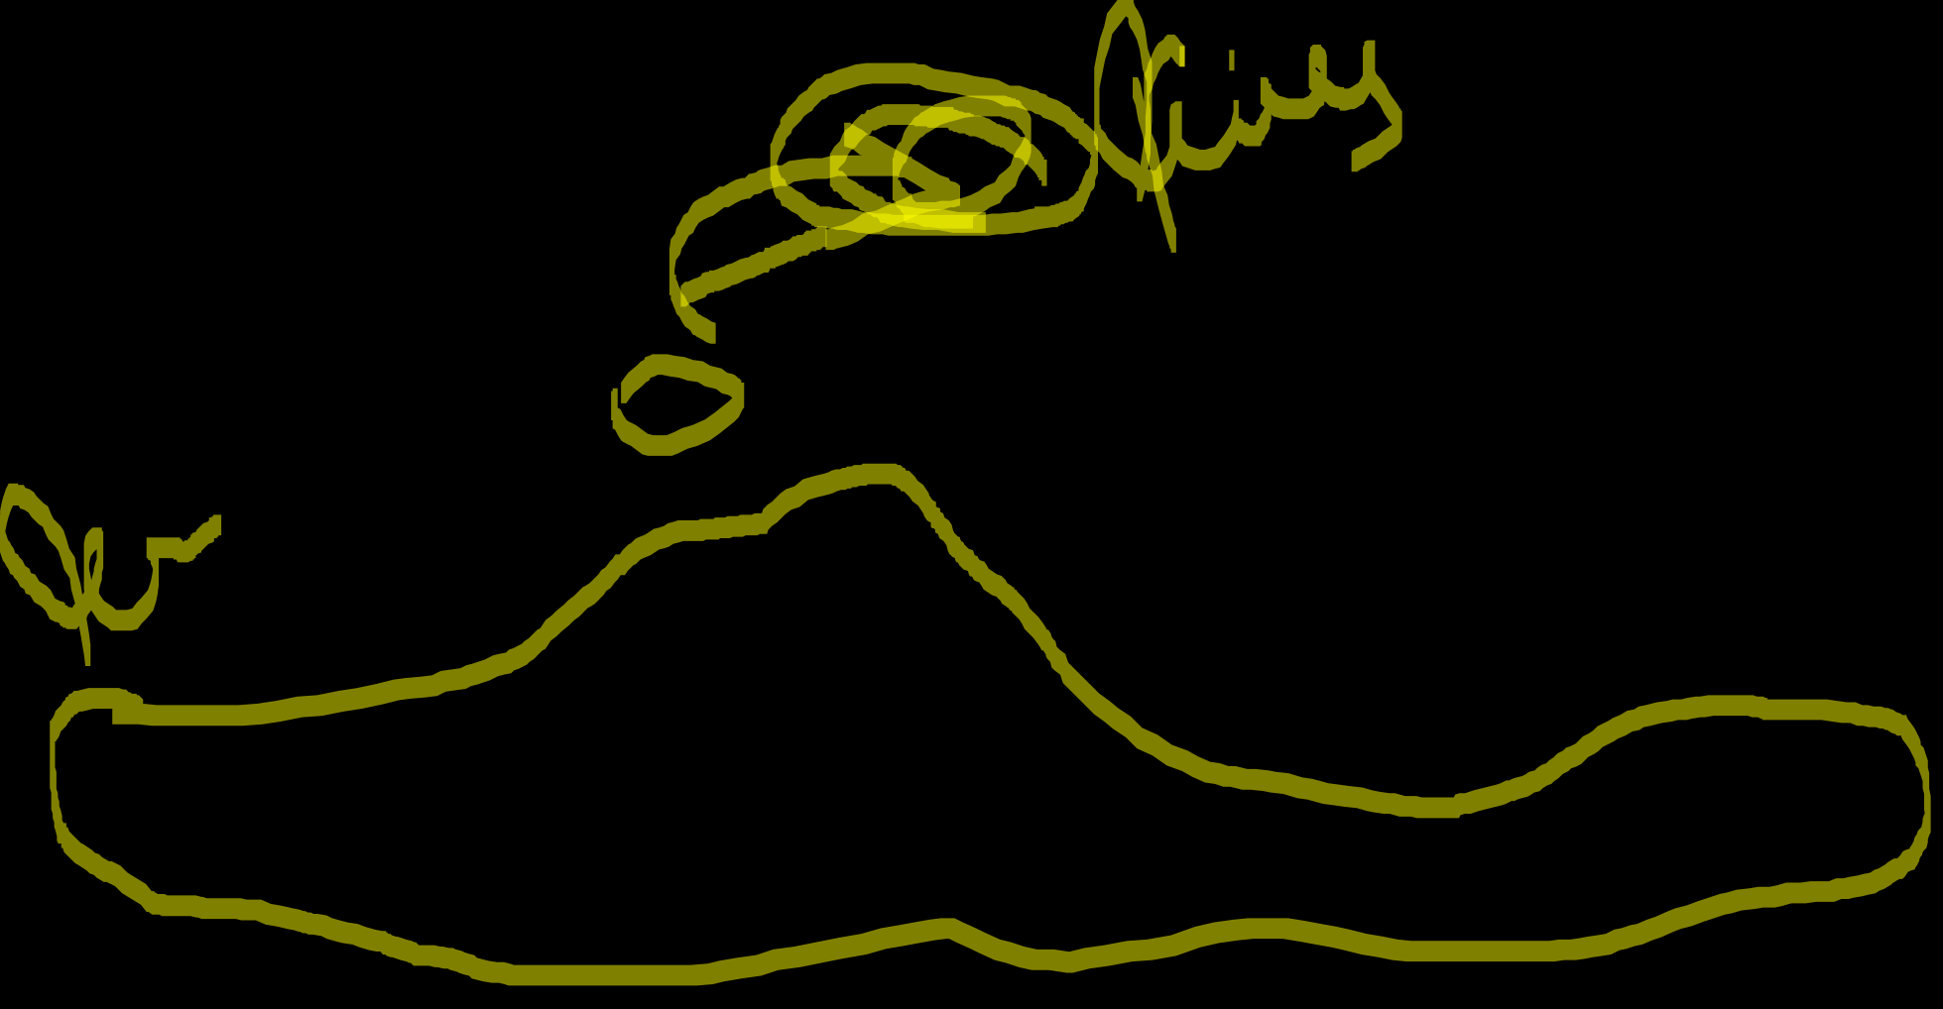
1
2
3
4
5
6
7
8
9
10
11
Notes:
Normal terminology – node, edges
Root
Leaf Parent Child (left, right)

Slide 6
What is Binary Tree?
Tree contains at most two children (i.e Not more the two)
A left child and A right child
Top most node in the binary tree are called ROOT (1)
Bottom most nodes are called LEAVES (8, 9, 5, 10, 11)

Slide 7
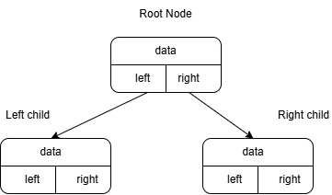

Representing Binary Tree

Slide 8
Traversal on Binary Tree
Visiting all nodes in the tree
Preorder
Inorder
Postorder

Slide 9

Node creation
public class Node { int data; Node left; Node right; public Node(int data) { this.data = data; left = right = null; } }

Slide 10
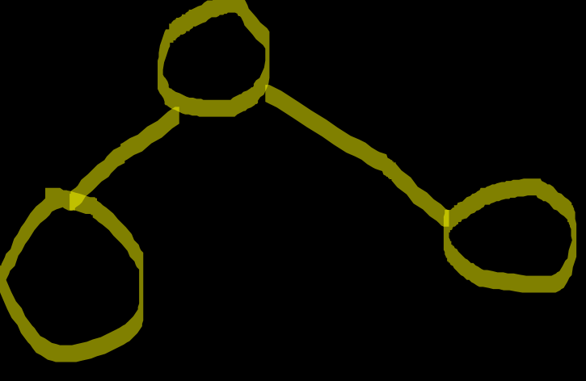
Preorder Traversal
Root – Left –Right policy

Slide 11
Steps in Preorder Traversing
1
2
3
4
5
6
Notes:
Root – Left –Right

Slide 12

Preorder Traversal
public class PreOrder { public static void main(String[] args) { Node root = new Node(1); root.left = new Node(2); root.right = new Node(3); root.left.left = new Node(4); root.left.right = new Node(5); root.right.right = new Node(6); System.out.println("Preorder Traversal:"); preorder(root); } private static void preorder(Node root) { if(root == null) { return; } System.out.print(root.data + " "); preorder(root.left); preorder(root.right); } }
Preorder Traversal:
1 2 4 5 3 6

Slide 13
Complexity Analysis
Tree Structure | Time Complexity | Space Complexity
Balanced Tree | O(N) | O(log N)
Skewed Tree | O(N) | O(N)

Slide 14
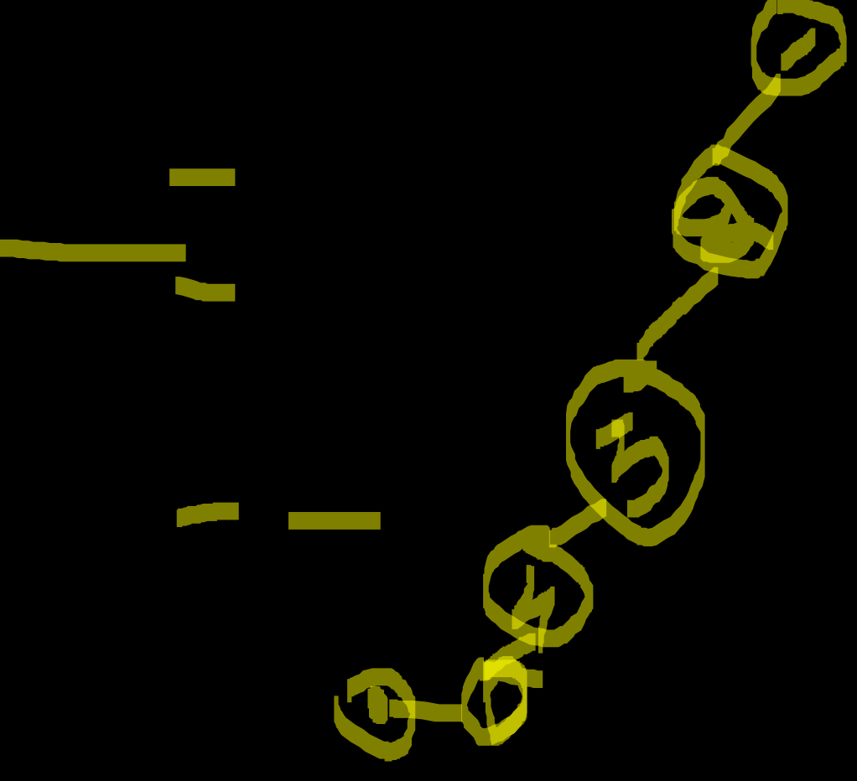
Analysing Space Complexity
PREORDER(1) --> Call Stack: [1]
├── 1 (print)
├── PREORDER(2) --> Call Stack: [1, 2]
│ ├── 2 (print)
│ ├── PREORDER(4) --> Call Stack: [1, 2, 4]
│ │ ├── 4 (print)
│ │ └── return --> Stack pops 4 → [1, 2]
│ ├── PREORDER(5) --> Call Stack: [1, 2, 5]
│ │ ├── 5 (print)
│ │ └── return --> Stack pops E → [1, 2]
│ └── return --> Stack pops 2 → [1]
├── PREORDER(3) --> Call Stack: [1, 3]
│ ├── 3 (print)
│ ├── PREORDER(6) --> Call Stack: [1, 3, 6]
│ │ ├── 6 (print)
│ │ └── return --> Stack pops 6 → [1, 3]
│ └── return --> Stack pops 3 → [1]
└── return --> Stack pops 1 → []

Slide 15
Inorder Traversal
Left - Root – Right policy

Slide 16
Steps in Inorder Traversing
1
2
3
4
5
6
Notes:
Left - Root – Right

Slide 17
Inorder Traversal
public class InOrder { public static void main(String[] args) { Node root = new Node(1); root.left = new Node(2); root.right = new Node(3); root.left.left = new Node(4); root.left.right = new Node(5); root.right.right = new Node(6); System.out.println("Inorder Traversal:"); inorder(root); } private static void inorder(Node root) { if(root == null) { return; } inorder(root.left); System.out.print(root.data + " "); inorder(root.right); } }
Inorder Traversal:
4 2 5 1 3 6

Slide 18
Complexity Analysis
Tree Structure | Time Complexity | Space Complexity
Balanced Tree | O(N) | O(log N)
Skewed Tree | O(N) | O(N)

Slide 19

Analysing Space Complexity
INORDER(1) --> Call Stack: [1]
├── INORDER(2) --> Call Stack: [1, 2]
│ ├── INORDER(4) --> Call Stack: [1, 2, 4]
│ │ ├── 4 (print)
│ │ └── return --> Stack pops 4 → [1, 2]
│ ├── 2 (print)
│ ├── INORDER(E) --> Call Stack: [1, 2, 5]
│ │ ├── 5 (print)
│ │ └── return --> Stack pops 5 → [1, 2]
│ └── return --> Stack pops 2 → [1]
├── 1 (print)
├── INORDER(3) --> Call Stack: [1, 3]
│ ├── INORDER(NULL) → return
│ ├── 3 (print)
│ ├── INORDER(6) --> Call Stack: [1, 3, 6]
│ │ ├── 6 (print)
│ │ └── return --> Stack pops F → [1, 3]
│ └── return --> Stack pops 3 → [1]
└── return --> Stack pops 1 → []

